Slide 1

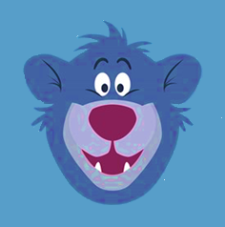

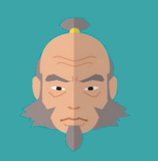
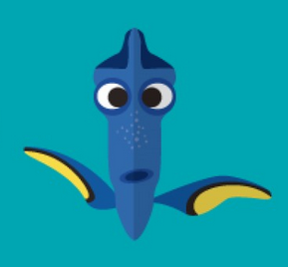








Emotional Coaching
From Cartoon Characters
Calmness
“You gotta stand up tall & learn to face your fears. You’ll see that they can’t hurt you. Just laugh to make them disappear!”
- Pinkie Pie
“Forget about your worries & your strife.” - Baloo
Optimism
“Never give into despair. Allow yourself to slip down that road, & you surrender to your lowest instincts.
In the darkest times, hope is something you give yourself. That is the meaning of inner strength.
“Just Keep Swimming.” - Dory
If you look to the light, often you will find it. But if
you look to the dark, that is all you will ever see.” - Iroh
Awareness
“Sometimes our strengths
lie beneath the surface.
Far beneath in some cases.”
- Moana
“The past can hurt. But you can either run from it or learn from it.” - Rafiki
Compassion
“If you walk the footsteps of a stranger, you’ll learn things you never knew you never knew.”
- Pocahontas
“A little consideration, a little thought for others makes all the difference.”
- Eeyore
Humility
“Pride is not the opposite of shame, but the source.
True humility is the only
antidote to shame.” - Iroh
“To laugh at yourself is to love yourself.”
– Mickey Mouse
Do Your Best
“It’s funny how some distance makes everything seem small.
And the fears that once
controlled me can’t
get to me at all.” - Elsa
“There’s been trials and tribulations, I know I’ve had my share. But there ain’t nothing gonna
stop me now cause I’m almost there.” - Tiana
Poster prepared by the Social Emotional Learning Research Group &
Dr. Kathleen Hughes, Department of Psychology, University of Calgary
Graphics & quotes from AAA State of Play, “Life Advice from 50 Beloved Characters”

